Slide 1
Spatially Distributed Hygrometer Measurements
Lori Fomenko, Brandon Holland, Tara Walsh

Slide 2
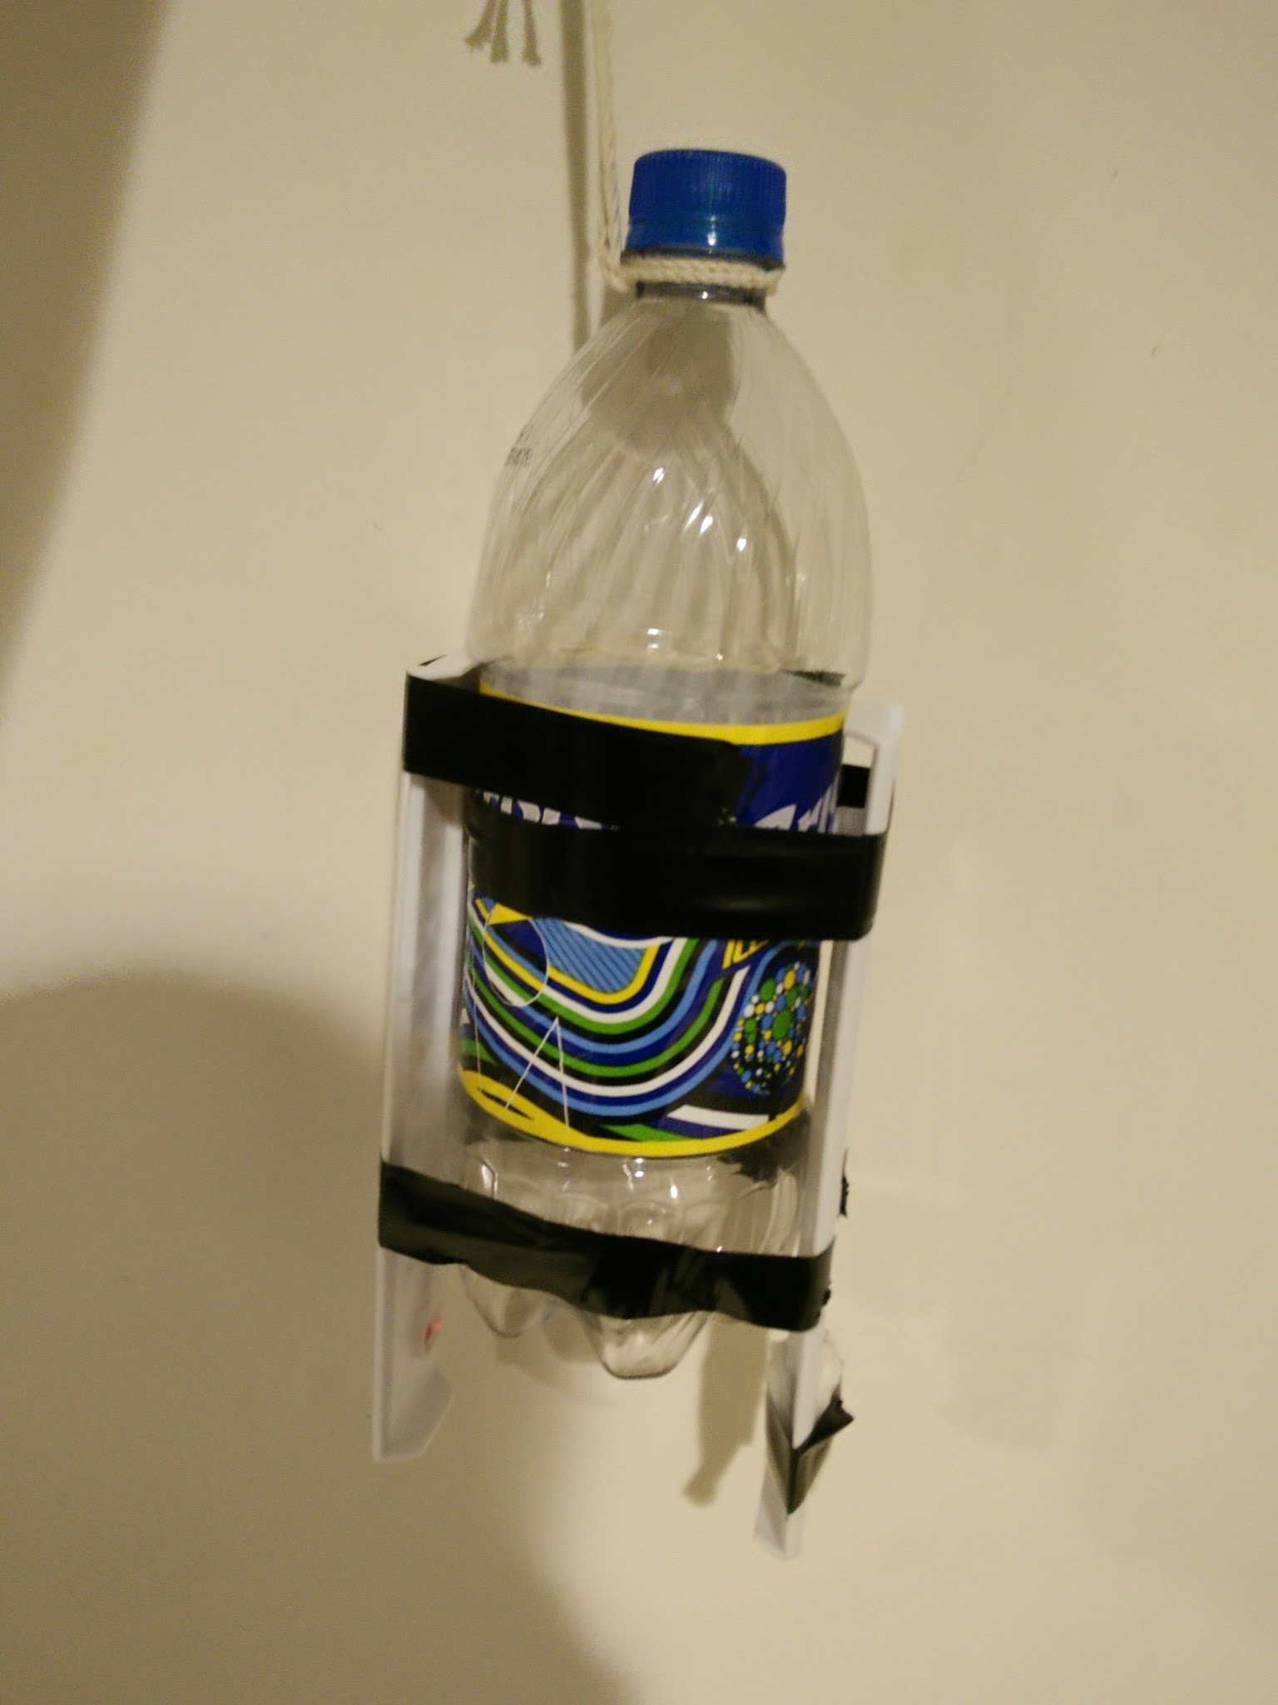
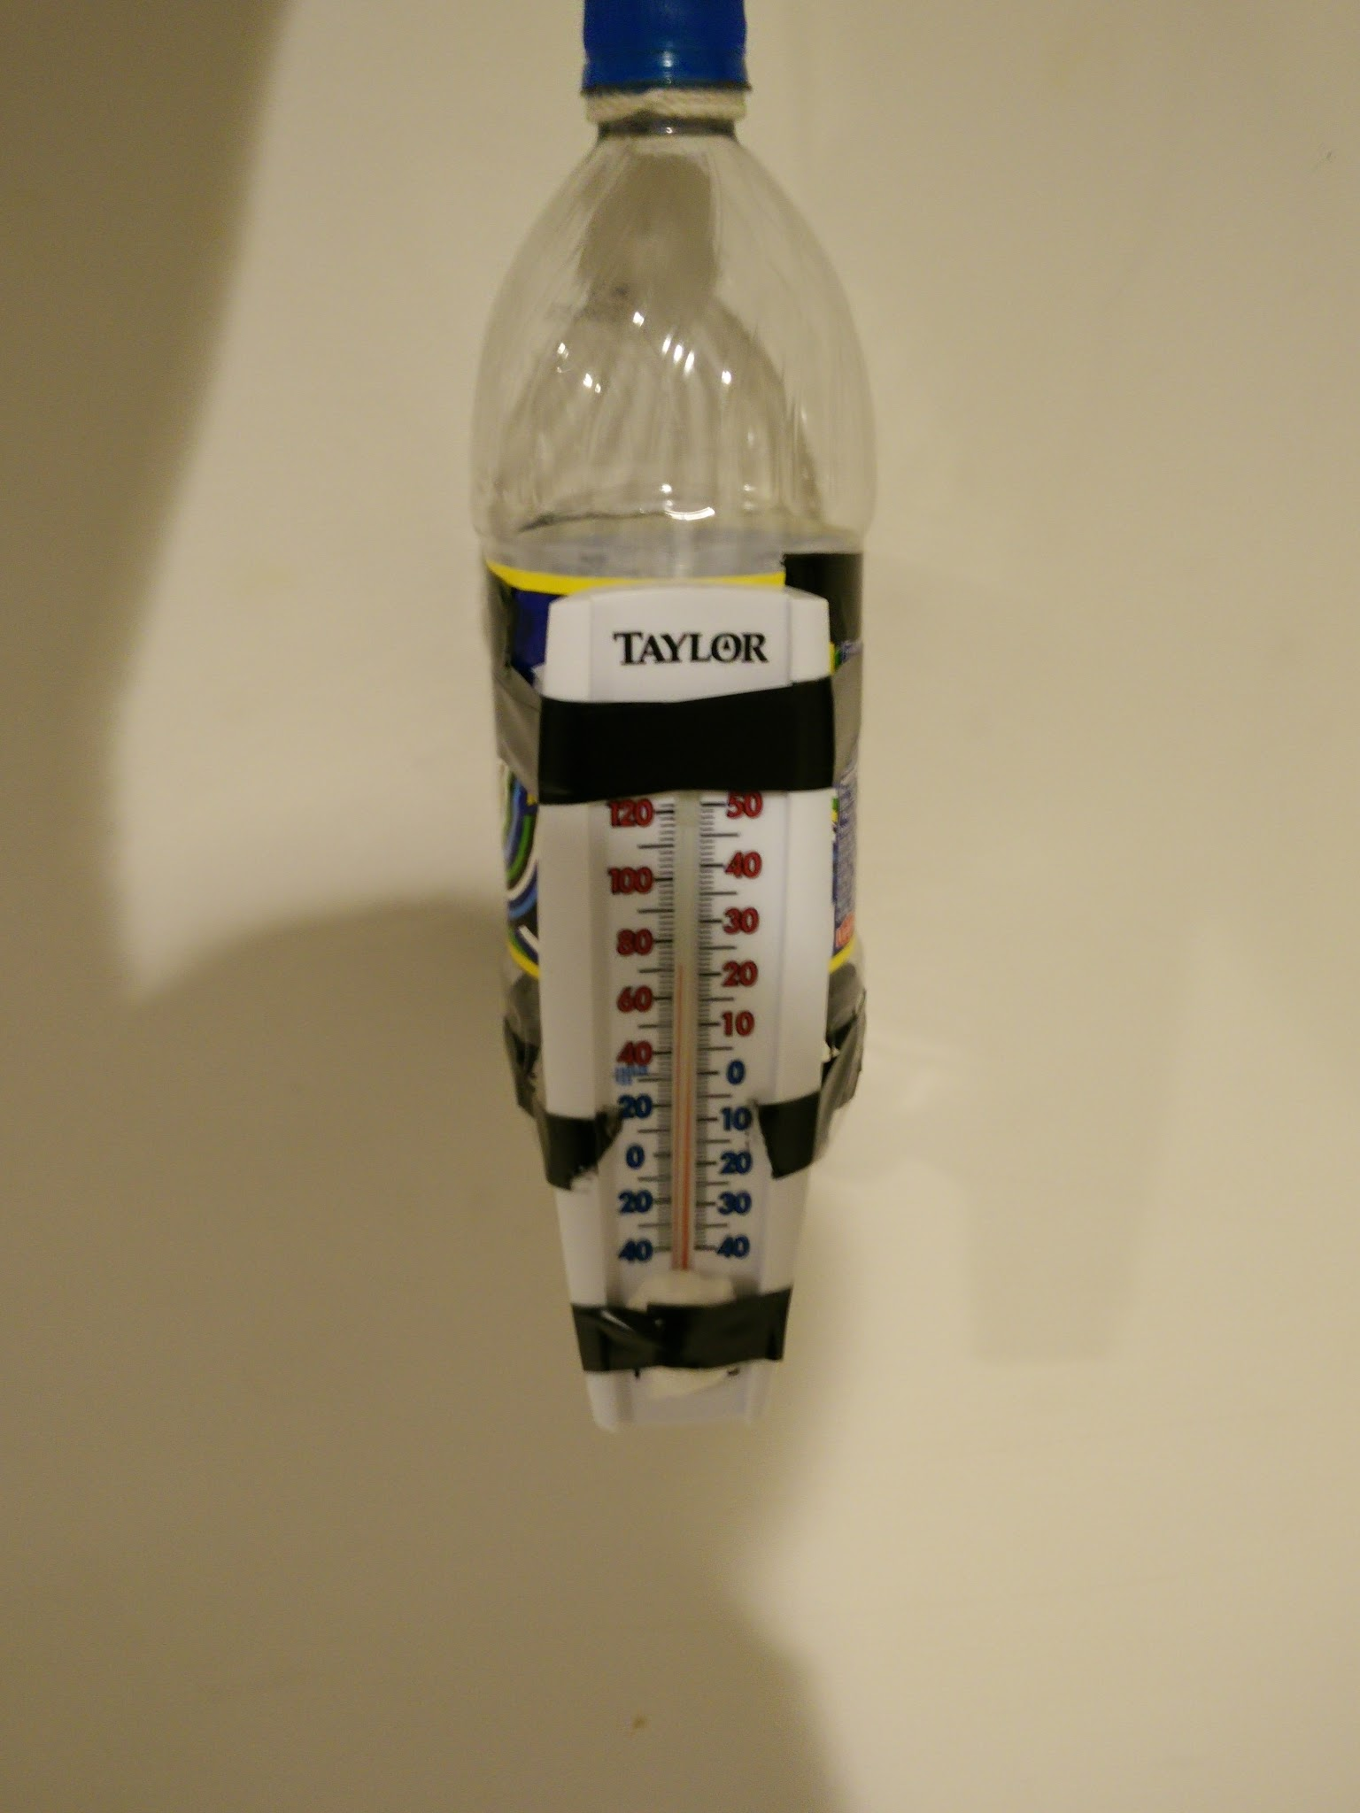
Introduction
Measuring moisture content, movement, composition, etc. at any given time is one of the most difficult, yet essential aspects of Atmospheric Thermodynamics
Popular instruments used to measure relative humidity, directly or indirectly, include psychrometers and hygrometers
Wet and Dry Bulb psychrometer is a type of hygrometer that uses two thermometers (pictured), in order to indirectly measure the relative humidity of the air
By exposure to air particles through movement, a wet bulb temperature is recorded as water evaporates from damp cotton, and a dry bulb temperature is recorded that gauges the temperature of the air

Slide 3
Methodology and Data Collection
Measurements taken after sunset, night temperatures, cooling
Timed 5 minute measurement rather than continuous to ensure wet bulb stays wet
Measurements taken between 7pm and 9pm
Calibration required for more accurate measurements. Allow hygrometer to adjust to outdoor temperature for 15-20 minutes.
Sources used for data comparison:
Quality Controlled Local Climatological Data (QCLCD) (Version 2.5.11)
Monthly Data with hourly measurements for the state of Connecticut
If hygrometer measurement was taken after 18:51 but before 19:51, the values for 18:51 were used. If measurement was taken after 19:51, the values from the 19:51 readings were used.
Downloaded in .txt format for Oct. and Nov. from https://www.ncdc.noaa.gov/qclcd/QCLCD
UConn weather station data
Daily Archive Records for T and Humidity with measurements recorded every five minutes throughout the course of the day
An average representative value was taken for each day based on the times of measurement for the hygrometers
http://137.99.85.41/weather/index.html
Notes:
Time of Day : 7 pm
Length of measurement: 90 seconds
Cotton Ball: split 1 jumbo cotton ball in half, and then halve again. 1 spoonful total for both sides, dipped and squeezed out until just damp, taped around 1 time
After attaching damp cotton balls to bulb, let calibrate for 5 minutes in location(A, B, or C), then take measurement. If < 0 degrees, calibration may take longer (i.e. 15-20 min)
Swing in circular motion
Take temperature reading within 5 seconds of stopped motion
Record wet bulb and dry bulb temperature in google doc
Calculate relative humidity based on Skew T-ln P chart
If the wet bulb temperature was greater than the dry bulb, Relative Humidity was automatically considered to be 100%. This was considered in error analysis, as it could artificially inflate the mean relative humidity for that day, as well as overall.

Slide 4
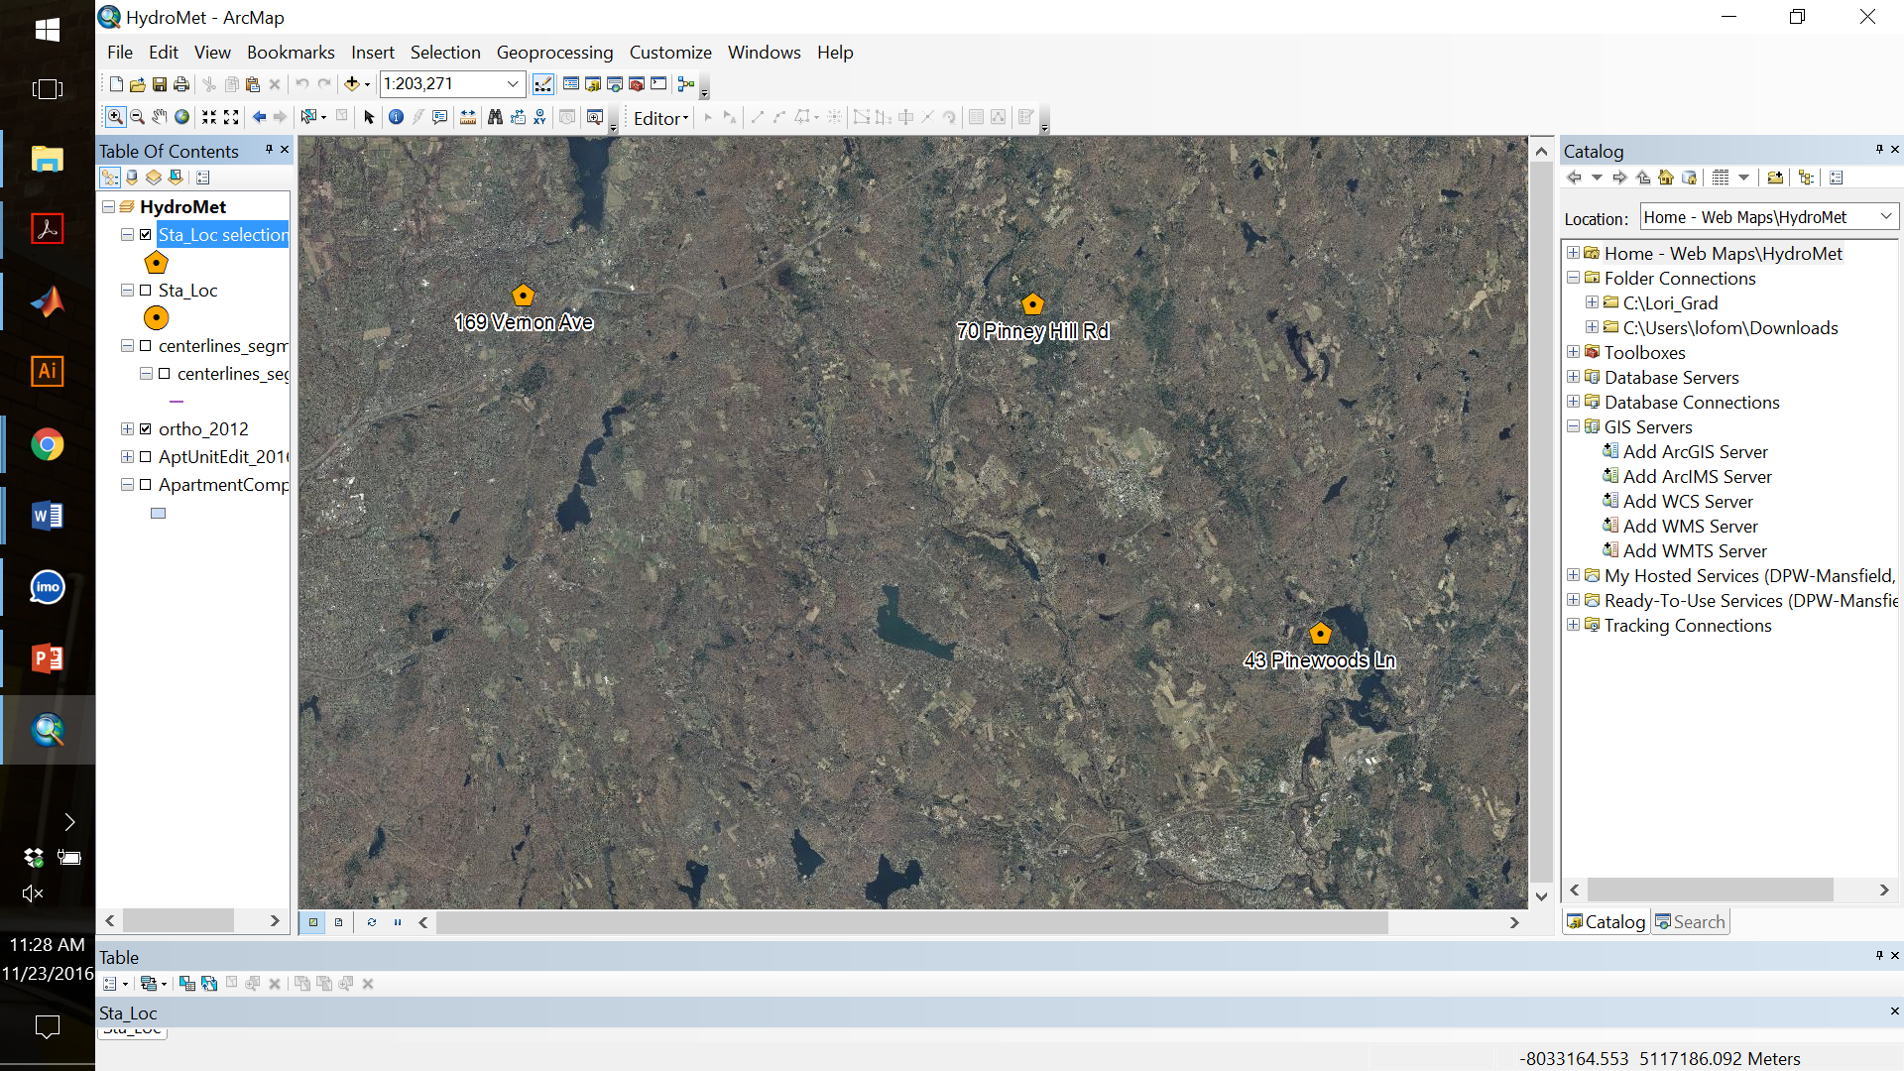
Spatial Distribution of Hygrometers
3 Locations
A : 43 Pinewoods Ln, Mansfield Center
B : 169 Vernon Ave, Vernon
C : 70 Pinney Hill Rd, Willington
Distance from A → B = 31.3 km
Distance from B → C = 18.4 km
Distance from C → A = 15.8 km
Area enclosed by ABC = 108 sq. km
Spatial Distribution of Hygrometer Station Locations

Slide 5
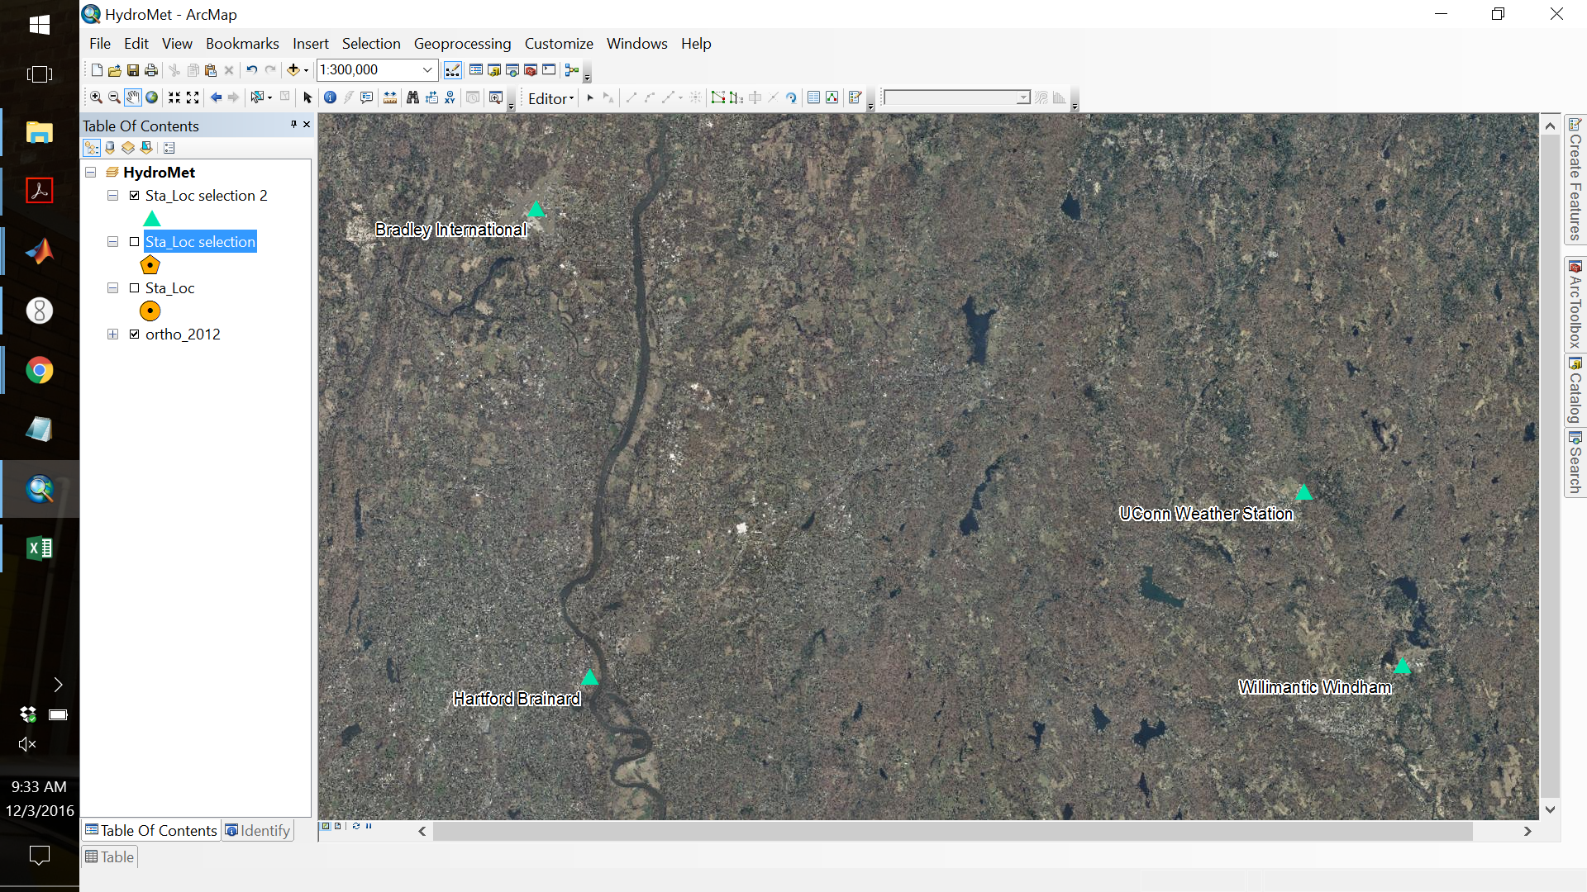
Spatial Distribution of Weather Stations
Windham → UConn : 12.78 km
UConn → Bradley: 52.39 km
Bradley → Brainard: 30.23 km
Brainard → Windham: 51.99 km
Station Network Area Coverage: 998 km^2
Spatial Distribution of Meteorological Station Locations

Slide 6
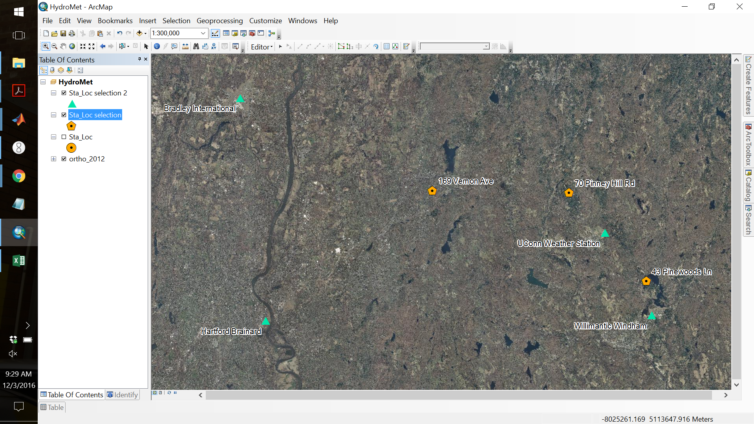
Spatial Distribution of All Stations
UConn Weather Station is the closest for Stations B (Pinney Hill Rd) and C (Vernon Ave)
B → UConn = 23.97 km
C → UConn = 7.28 km
The Willimantic Windham station is nearest to Station A (Pine Woods Ln)
A → Windham = 4.71 km

Slide 7
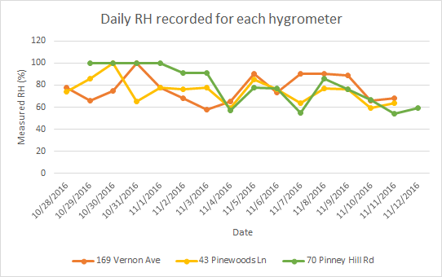
Results

Slide 8
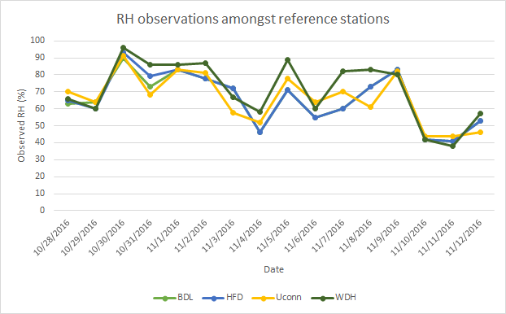

Slide 9
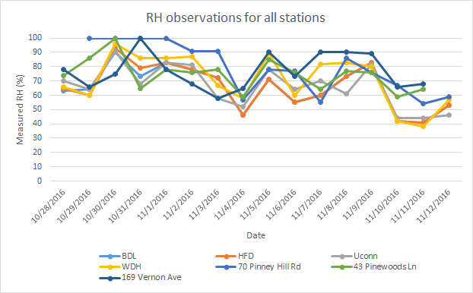

Slide 10
Data Analysis
ANOVA for station data showed no statistical difference in location.
Compared each experimental location to the nearest station.
ANOVA comparing the experimental locations showed no statistical difference between locations.
ANOVA with and without data points taken before 7:00 pm or after 8:00 pm.
Paired t-test (alpha= 0.05):
Paired t-test | P value | RMSE | Mean bias
All locations | 8.0E-5 | 16.2% | 9%
Location A only | 0.13 | 13.5% | 5%
Location B only | 0.021 | 16.9% | 10%
Location C only | 0.005 | 17.9% | 12%

Slide 11
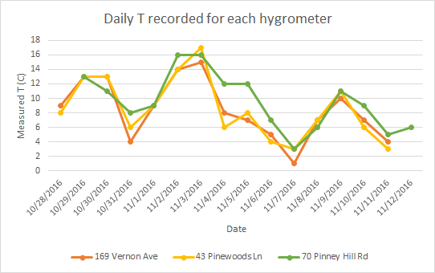

Slide 12
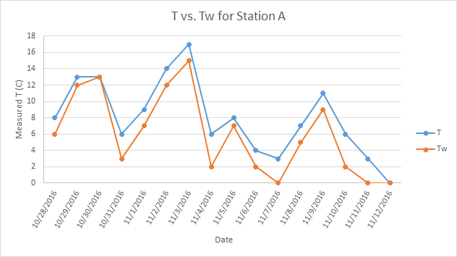

Slide 13
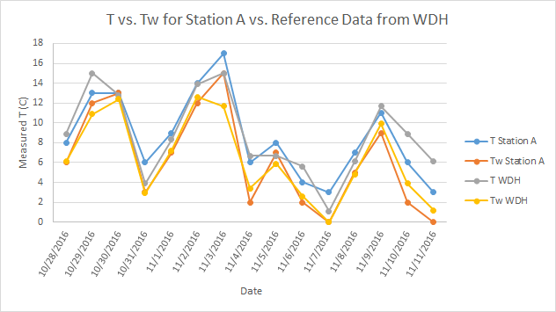

Slide 14
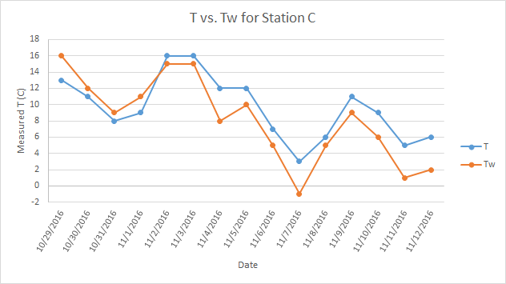

Slide 15
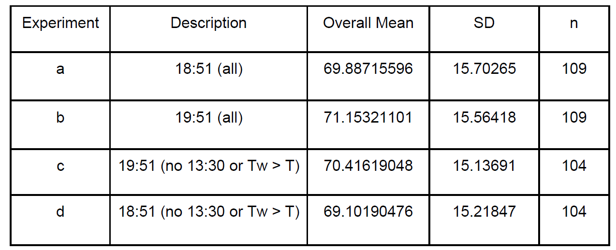

Slide 16
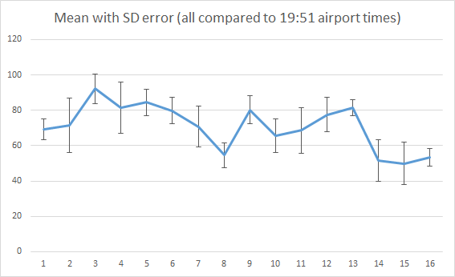

Slide 17
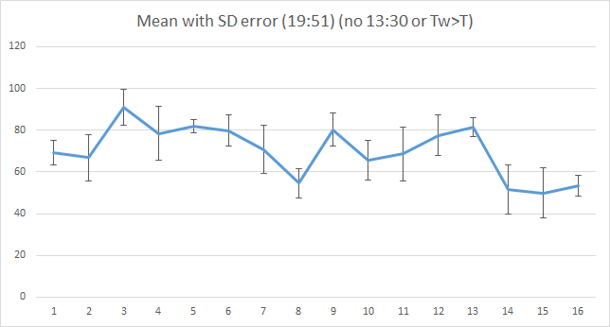
Notes:
11/1/2016

Slide 18
Conclusion
-Paired t-test comparison of all experimental data(excluding outliers) to nearest station data shows significant difference in RH values.
-Paired t-test for individual locations results in location A RH values statistically indifferent, while locations B and C result in significant difference in RH values.
-Hygrometer measurements using this method may result in accurate results as demonstrated at location A.
-Future studies aimed at interpolating station data to get a better representative comparison of RH

Slide 19


Slide 20
References
1. Wallace J., and P. Hobbs, Atmospheric Science, An Introductory Survey, Academic-Press, 2006, 2nd edition.
2. Dingman, S.L., Physical Hydrology, Second Edition, Waveland Press Inc., 2002.
3. Chow, V.T., D.R. Maidment, and L.W. Mays, Applied Hydrology, McGraw-Hill, 1988.
4. Wexler, Arnold, and W. G. Brombacher. Methods of measuring humidity and testing hygrometers. US Government Printing Office, 1951.

Slide 21
Supplementary Slides

Slide 22
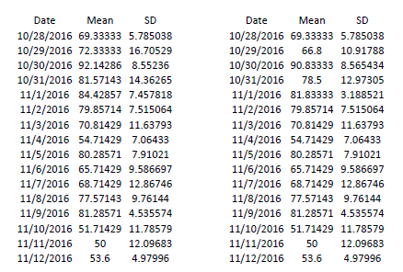
Notes:
Daily difference between 19:51 and 19:51 (excl. 13:30 and Tw > T)

Slide 23
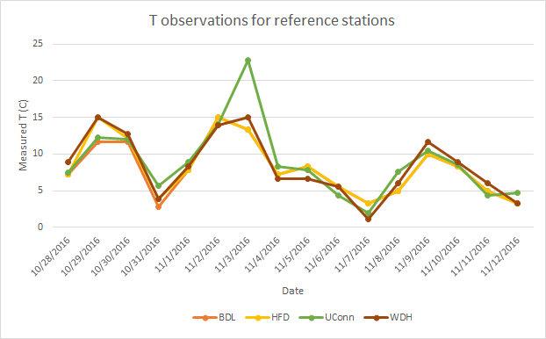

Slide 24
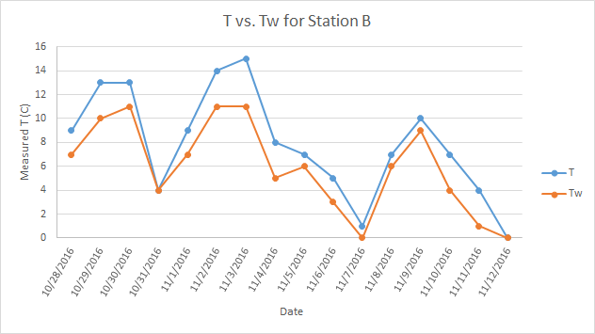

Slide 25
Data and Error Analysis
We analyzed the results, and calculated the daily and overall sample mean and standard deviation for:
Hygrometer measurements only taken between 18:51 and 19:51, compared against UConn, and airport station hourly data recorded at 18:51
Hygrometer measurements only taken after 19:51, compared against UConn, and airport station hourly data recorded at 19:51
All Hygrometer measurements, compared against UConn, and airport station hourly data recorded at 18:51
All Hygrometer measurements, compared against UConn, and airport station hourly data recorded at 19:51
All Hygrometer measurements (except an outlier measurement taken at 13:30), compared against UConn, and airport station hourly data recorded at 18:51
All Hygrometer measurements (except an outlier measurement taken at 13:30), compared against UConn, and airport station hourly data recorded at 18:51

Slide 26
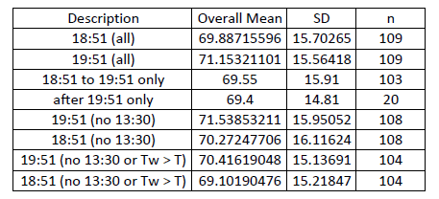
Data and Error Analysis
All Hygrometer measurements (except an outlier measurement taken at 13:30 and measurements where the Wet Bulb T > Dry Bulb T), compared against UConn, and airport station hourly data recorded at 18:51
All Hygrometer measurements (except an outlier measurement taken at 13:30 and measurements where the Wet Bulb T > Dry Bulb T), compared against UConn, and airport station hourly data recorded at 18:51

Slide 27
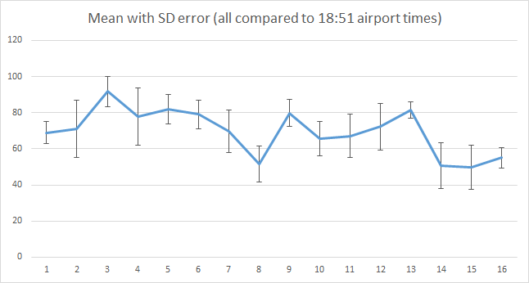

Slide 28
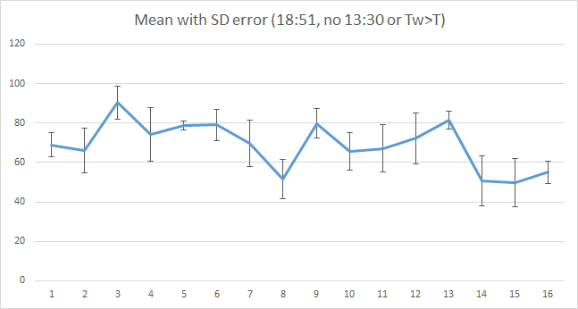

Slide 29
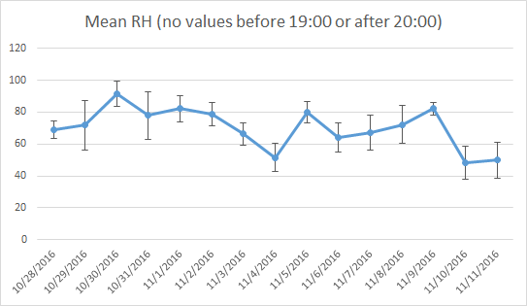

Slide 30
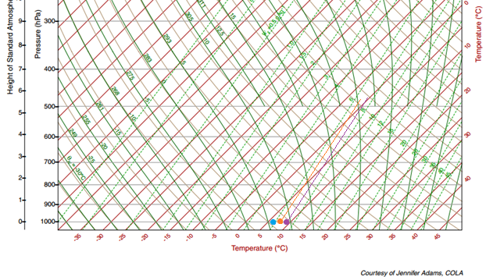

Slide 31
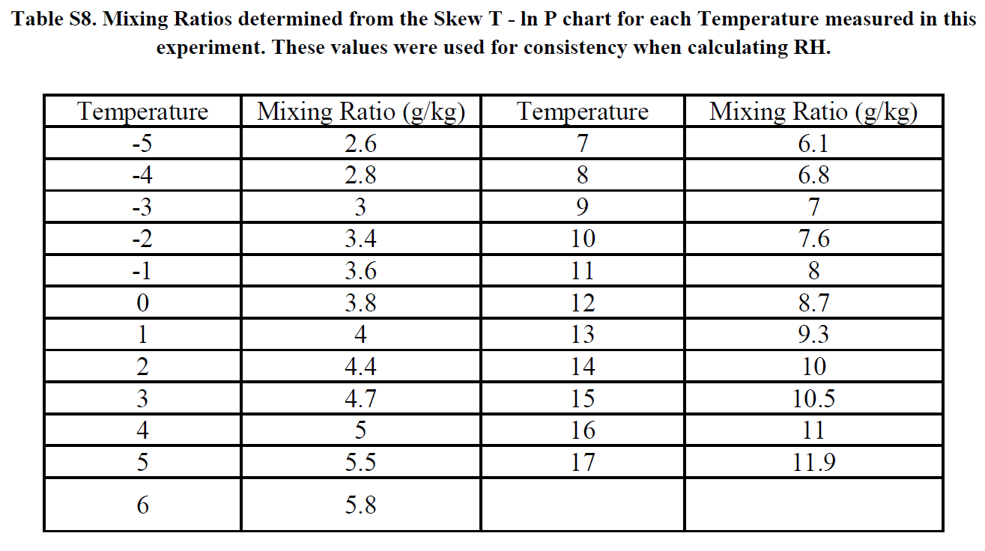

Slide 32
Reference Station | Coordinates
HFD | Lat. = 41.736, Long. = -72.650
BDL | Lat. = 41.937, Long. = -72.681
WDH | Lat. = 41.741, Long. = -72.183
UConn | Lat. = 41.815, Long. = -72.240

